Slide 1
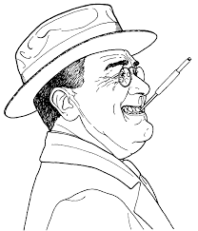
FDR

Slide 2
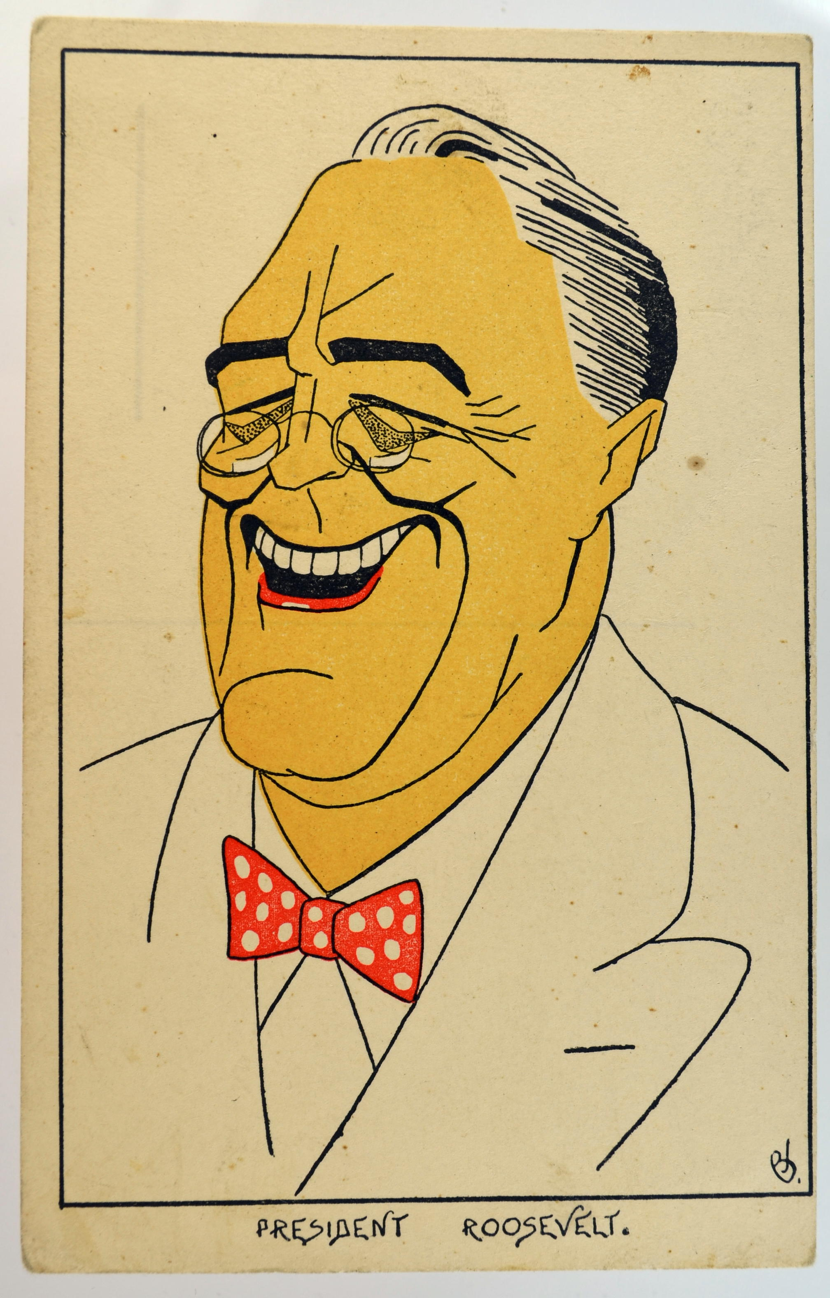
FRANKLIN ROOSEVELT
(1882-1945)
MARRIED 5TH COUSIN (ELEANOR—NIECE OF Teddy Roosevelt
ASSISTANT SECRETARY OF NAVY (1912-1918)

Slide 3
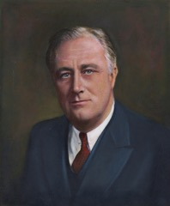
FRANKLIN ROOSEVELT
(1882-1945)
1920: RAN FOR VICE PRESIDENT WITH JAMES COX
1921 CONTRACTED POLIO
1928 GOVERNOR OF NEW YORK
1932 ELECTED PRESIDENT OF UNITED STATES

Slide 4
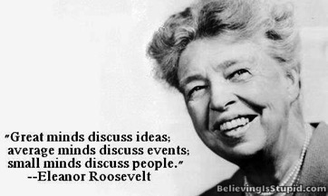
ELEANOR ROOSEVELT
1888-1962
“PRESIDENT’S EYES, EARS, AND LEGS”
ADVOCATE FOR POOR, MINORITIES, WOMEN AND JAPANESE
1939 PRESS CONFERENCE-- ONLY WOMEN REPORTERS
SUPPORTED TUSKEGEE AIRMEN

Slide 5
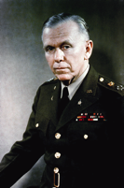
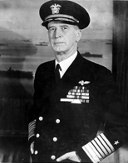
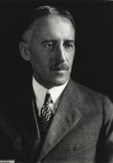
FDR BRILLIANT WARTIME LEADER
EMPHASIZED EUROPE FIRST OVER PACIFIC
SOVIET UNION RECEIVED 20% LEND LEASE
PROMOTED D-DAY INVASION
CHOSE EXCELLENT COMMANDERS
  GEORGE MARSHALL, ERNIE KING, HENRY STIMSON

Slide 6
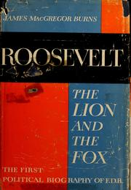
FRANKLIN ROOSEVELT
LION AND FOX LEADERSHIP SKILLS TO OVERCOME ISOLATIONIST CONGRESS AND PUBLIC ATTITUDES
SPECTACULAR COMMANDER IN CHIEF
OVERSAW NEGOTIATIONS
  BRITISH VS. U.S.
  AMERICAN NAVY, ARMY, AND
  AIRFORCE DISAGREEMENTS

Slide 7
QUARANTINE SPEECH
OCT 5, 1937
INTERNATIONAL QUARANTINE AGAINST EPIDEMIC OF WORLD LAWLESSNESS
INTENSIFIED AMERICA’S ISLOATIONIST MOOD
“TERRIBLE THING TO LOOK BEHIND YOU AND SEE NOBODY”

Slide 8
FDR BRILLIANT WARTIME LEADER
EMPHASIZED EUROPE FIRST OVER PACIFIC
PROVIDE LEND LEASE SOVIET UNION—RUSSIA RECEIVED 20%
INVADE NORTH AFRICA-1942
FDR KNEW ALLIES WERE NOT PREPARED TO INVADE ACROSS ENGLISH CHANNEL

Slide 9
ROOSEVELT NEEDED TO ARBITRATE DIFFERENCES OF OPINION
WAR AIM CONFLICT: BRITAIN, U.S., SOVIET UNION
EMPHASIZE EUROPE OVER PACIFIC
ATTACK EUROPEAN CONTINENT VS. BALKANS

Slide 10
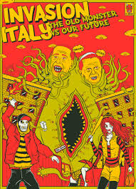
ROOSEVELT NEEDED TO ARBITRATE DIFFERENCES OF OPINION
INVADE ITALY
OPPOSED INVASION BALKANS… “SOFT BELLY OF EUROPE”
ARBITRATED INTERSERVICE RIVALRY

Slide 11
CHURCHILL PRAISE FDR 1942
“IF ANYTHING HAPPENED TO THE MAN, I COULD NOT STAND IT.”
HE IS THE TRUEST FRIEND
HE HAS THE FURTHEST VISION
HE IS THE GREATEST MAN THAT I HAVE EVER KNOWN

Slide 12
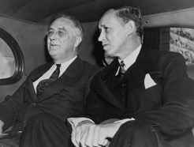
HARRY HOPKINS
(1890-1946)
1933: SUPERVISED FEDERAL EMERGENCY RELIEF ADMINISTRATION, CIVIL WORKS ADMINISTRATION
STOMACH CANCER LATE 1930S
MAY 10, 1940 INVITED TO STAY OVERNIGHT IN WHITE HOUSE. LIVED OVER 3 YEARS
FDR’S CLOSEST ADVISOR

Slide 13
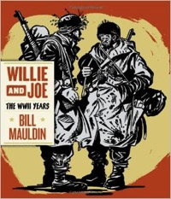
GEORGE MARSHALL
(1880-1959)
AMERICA’S GREATEST 20TH CENTURY BUREAUCRAT
CHIEF OF STAFF U.S. ARMY
  CHIEF MILITARY ADVISOR TO FDR
  OVERSAW ARMY BUILD UP FROM 200,000 TO 10 MILLION
  UNDERSTOOD IMPORTANTCE OF G.I.
  WELL FED, WELL PAID, CLOTHED,
  TRAINED.

Slide 14
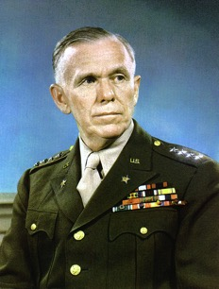
GEORGE MARSHALL
(1880-1959)
SECRETARY OF STATE
  MARSHALL PLAN
  RECEIVED NOBEL PEACE PRIZE
SECRETARY OF DEFENSE
Sen. JOE McCarthy SAID:
"A CONSPIRACY ON A SCALE SO IMMENSE AS TO DWARF ANY PREVIOUS SUCH VENTURE IN THE HISTORY OF MAN.”

Slide 15
WHY FDR NEEDED GEORGE MARSHALL NEAR HIM!
  1. MARSHALL VERY EFFECTIVE WITH CONGRESS
  2. WORKED HARD TO OVERCOME INTERSERVICE RIVALRY
  3. DEVELOPED CLOSE RELATIONSHIP WITH SIR JOHN DILL, CHIEF BRITISH MILITARY REPRESENTATIVE TO WASHINGTON.

Slide 16
FRICTION—WHY FDR NEEDED GEORGE MARSHALL NEAR HIM!
  4. SUPPORTED AIR FORCE
  While I don't go so far as to claim that air power alone will win the war, I do claim the war will not be won without it.”
  ROBERT LOVETT—ASST SECRETARY OF WAR

Slide 17
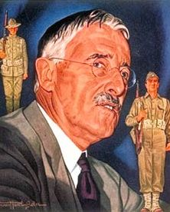
HENRY STIMSON
(1867-1950)
SERVED IN EVERY ADMINISTRATION FROM TED ROOSEVELT TO HARRY TRUMAN
SECRETARY OF STATE (1929-1933)
JUNE 1940 JOINED FDR AS SECRETARY OF WAR TO BOLSTER BI-PARTISAN UNITY
OPPOSED MORGENTHAU PLAN TO DE-INDUSTRIALIZE GERMANY
DIRECT CONTROL ATOMIC BOMB PROJECT

Slide 18
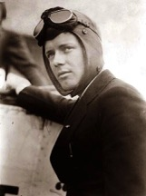
CHARLES LINDBERGH
(1902-1974)
1927-NONSTOP FLIGHT ROOSEVELT FIELD TO PARIS
MOST FAMOUS SPOKESMAN FOR AMERICA FIRST COMMITTEE
OPPOSED LEND-LEASE
FDR CALLED LINDBERGH “DEFEATIST AND APPEASER”

Slide 19
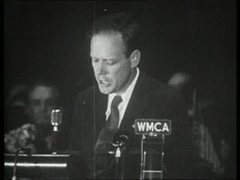
CHARLES LINDBERGH
(1902-1974)
DES MOINES SPEECH SEPTEMBER 11, 1941
JEWS, BRITISH PEOPLE, ROOSEVELT ADMINISTRATION “PRESSING THIS COUNTRY FOR WAR.”
LINDBERGH AND HENRY FORD RECEIVED “ORDER OF GERMAN EAGLE”

Slide 20
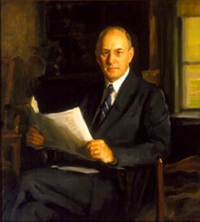
HENRY MORGENTHAU JR.
(1891-1967)
HYDE PARK FRIEND AND NEIGHBOR FDR
SECRETARY OF TREASURY 1934-1945
PROPOSED MORGENTHAU PLAN
  DE-INDUSTRIALIZE GERMANY, BREAK-UP COUNTRY
CREATED U.S. REFUGEE BOARD TO SAVE HUNDREDS OF THOUSANDS OF JEWS

Slide 21
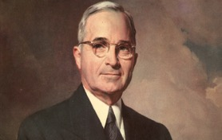
HARRY TRUMAN
(1884-1972)
WORKED AS FARMER BEFORE WWI
LIVED IN MOTHER-IN-LAW HOUSE HIS WHOLE MARRIED LIFE
TRUMAN COMMITTEE-MARCH 1941 INVESTIGATE WASTE, FRAUD, AND CORRUPTION WARTIME CONTRACTS
APPROVED USE ATOMIC BOMB

Slide 22
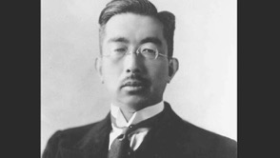
EMPEROR HIROHITO
(1901-1989)
EMPEROR 1926-1989
APPROVED JAPANESE ATTACK ON BRITAIN AND UNITED STATES
JUNE 1944 ENCOURAGED JAPANESE CIVILIANS TO COMMIT SUICIDE IN SAPPAN
AUGUST 15 EMPEROR RAIDO ADDRESS URGING UNCONDITIONAL SURRENDER “ENDURE THE UNENDURABLE”

Slide 23
AMERICAN NEUTRALITY LAWS
NOVEMBER 1935, 1936,1937, 1939
LIFTED ARMS EMBARGO AND PUT ALL TRADE WITH BELLIGERENT NATIONS UNDER CASH AND CARRY
AMERICAN SHIPS BARRED FROM TRANSPORTING GOODS TO BELLIGEENT PORTS

Slide 24
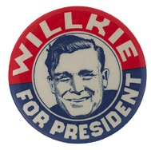
WENDELL WILKIE
(1892-1944)
REBUKED ISOLATIONISTS SUCH AS ROBERT TAFT
SUPPORTED LEND-LEASE ACT
JULY 23, 1941 URGED UNLIMITED AID TO BRITAIN AGAINST NAZI GERMANY

Slide 25
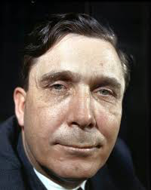
WENDELL WILKIE
(1892-1944)
1940 REPUBLICAN NOMINEE FOR PRESIDENT
INTERVENTIONIST: SUPPORTED AID FOR BRITAIN
MADE 2 WARTIME FOREIGN TRIPS AS ROOSEVELT’S INFORMAL ENVOY

Slide 26
ROOSEVELT ELECTED THIRD TERM
ROOSEVELT ONLY PRESIDENTIAL CANDIDATE WHO COULD BE EFFECTIVE MILITARY LEADER
DEMOCRATIC CHALLENGERS—JAMES FARLEY, JOHN NANCE GARNER ISOLATIONISTS

Slide 27
DESTROYER BASES AGREEMENT
SEPT 2, 1940
50 WORLD WAR I WARSHIPS TRANSFERRED TO ROYAL NAVY
US GOT RIGHTS TO AIRFIELDS TRINIDAD, BERMUDA, AND NEWFOUNDLAND
START OF WARTIME ANGLO-AMERICAN PARTNERSHIP

Slide 28
LEND LEASE
MARCH 1941
PRINCIPAL MEANS FOR PROVIDING U.S. MILITARY AND FOREIGN AID TO ALLIES IN WORLD WAR 2
$50 BILLION
BRITAIN, SOVIET UNION, AND CHINA PRIMARY BENEFICIARIES

Slide 29
ATLANTIC CHARTER AUGUST 14,1941
OUTLINED MORAL OBJECTIVES OF ALLIED DEMOCRACIES IN OPPOSING AXIS TYRANNY
ENVISIONED INDEPENDENCE BOTH FOR COUNTRIES OCCUPIED BY NAZI GERMANY BUT ALSO COLONIAL PEOPLE

Slide 30
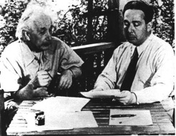
MANHATTAN PROJECT
LEO SZILARD AND EINSTEIN DRAFTED LETTER TO FDR “EXTREMELY POWERFUL BOMB”
OCTOBER 1941 FDR APPROVED MANHATTAN PROJECT
“IF GERMANY CONQUERED ALL OF EUROPE, AMERICA COULD STILL WIN WAR WITH ATOMIC BOMB.”
HIROSHIMA AND NAGASAKI BOMBED AUG 1945
LEO SZILARD

Slide 31
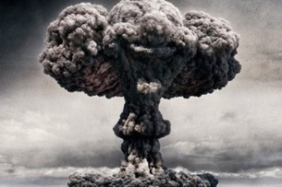
MANHATTAN PROJECT
(1939-1945)
LED BY U.S. WITH SUPPORT FROM GREAT BRITAIN AND CANADA
UNDER DIRECTION OF LESLIE GROVES AND ROBERT OPPENHEIMER
EMPLOYED 130,000 PEOPLE; COST $2 BILLION,($26 BILLION IN TODAY’S DOLLARS)
30 SITES

Slide 32
JAPAN
LACKED OIL, RUBBER, AND OTHER NATURAL RESOURCES
ENVIOUS DUTCH, FRENCH AND BRITISH COLONIES
HITLER VICTORIES IN EUROPE ENCOURAGED JAPAN TO ATTACK EUROPEAN COLONIES

Slide 33
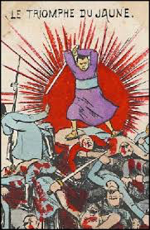
JAPAN AGGRESSION
INVADED MANCHURIA 1931
INVADED CHINA 1937
US BANNED METAL AND OIL PRODUCTS LATE 1940
INVADED INDOCHINA 1941

Slide 34
FDR REACTION TO JAPAN INVASION INDOCHINA
TOOK CONTROL OF ALL JAPANESE MONEY IN U.S.
BROUGHT ARMED FORCES IN PHILIPPINES UNDER AMERICAN COMMAND
CLOSED PANAMA CANAL TO JAPANESE SHIPPING

Slide 35
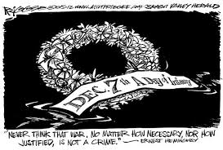
PEARL HARBOR
DECEMBER 7, 1941
FORTUNATELY AMERICAN AIRCRAFT WERE AWAY
OIL STORAGE DEPOSITS, REPAIR SHOPS, SHIPYARDS, AND SUBMARINE DOCKS NOT DAMAGED

Slide 36
PEARL HARBOR
DECEMBER 7, 1941
DEVASTATING SURPRISE ATTACK
DESTORY OR DAMAGE 20 AMERICAN NAVAL VESSELS
2400 AMERICANS DIED
FORTUNATELY AMERICAN AIRCRAFT WERE AWAY

Slide 37
BATTLE OF ATLANTIC
HEIGHT 1939-1943
U BOATS VS. ROYAL NAVY, US CONVOYS, ALLIED MERCHARNT SHIPPING
1000’S OF ENGAGEMENTS
BRITAIN DEPENDENT UPON IMPORTED GOODS
LONG RANGE AIRCRAFT, SEA SCANNING RADAR GAVE ALLIES UPPER HAND

Slide 38
DECLARE WAR ON JAPAN 12/8/1941
WE WILL NEVER KNOW WHY AMERICA DID NOT DECLARE WAR ON GERMANY
WAS FDR WORRIED ABOUT DIVIDED CONGRESS?
DID FDR KNOW THAT HITLER WOULD DECLARE WAR ON US?

Slide 39
HITLER DECLARE WAR ON U.S. DEC 11….MISTAKE
HOPED JAPAN WOULD DECLARE
WAR ON USSR
GERMAN NAVY WANTED TO USE U BOATS AGAINST U.S.
THOUGHT U.S. WEAKENED BY PEARL HARBOR
BELIEVED 1942 KNOCK OUT RUSSIA
UNDERESTIMATED US PRODUCTION CAPACITY

Slide 40
ARCADIA CONFERENCE
DEC 22,1941 - JAN 14, 1942
TOP BRITISH AND AMERICAN MILITARY LEADERS MEET IN WASHINGTON
INVADE NORTH AFRICA 1942
SEND AMERICAN BOMBERS TO BASES IN ENGLAND
COMBINED CHIEF OF STAFF WHICH APPROVED ALL MILITARY DECISIONS

Slide 41
OPERATION TORCH
NOV 1942-MAY 1943
JOINT AMERICAN AND BRITISH AMPHIBIOUS OPERATION AGAINST FRENCH NORTH AFRICA
FDR OVERRODE AMERICAN STRATEGISTS
POSTPONED FRENCH LANDING UNTIL 1944

Slide 42
OPERATION TORCH
GENERAL MARSHALL WANTED TO CONCENTRATE FORCES AGAINST NAZI GERMANY
FIELD MARSHALL ALAN BROOKE NOT OPTIMISTIC ABOUT CROSS-CHANNEL OPERATION
ESTABLISH EFFECTIVE ANGLO-AMERICAN MILITARY COOPERATION

Slide 43
OPERATION TORCH
TRANSPORT 65,000 MEN UNDER EISENHOWER
INITIALLY OPPOSED BY VICHY FRENCH FORCES
OPEN MEDITERRANEAN SEA LINES
MAY 1943 GERMAN AND ITALIAN SURRENDER

Slide 44
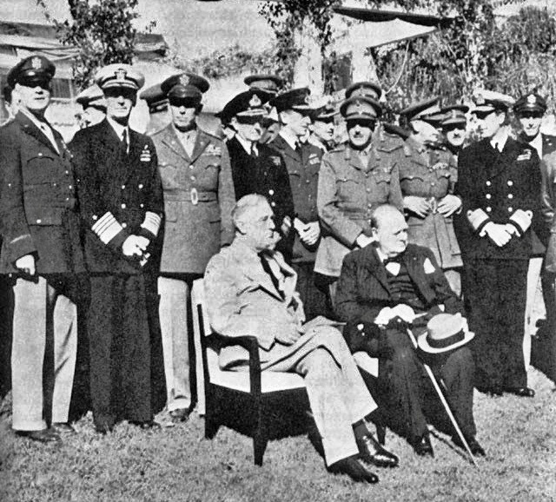
CASABLANCA CONFERENCE
JAN 14-24, 1943
UNCONDITIONAL SURRENDER
INVADE SICILY AND MAINLAND ITALY
FDR FAULTED BRITISH FOR NOT FULL COMMITMENT AGAINST JAPANESE

Slide 45
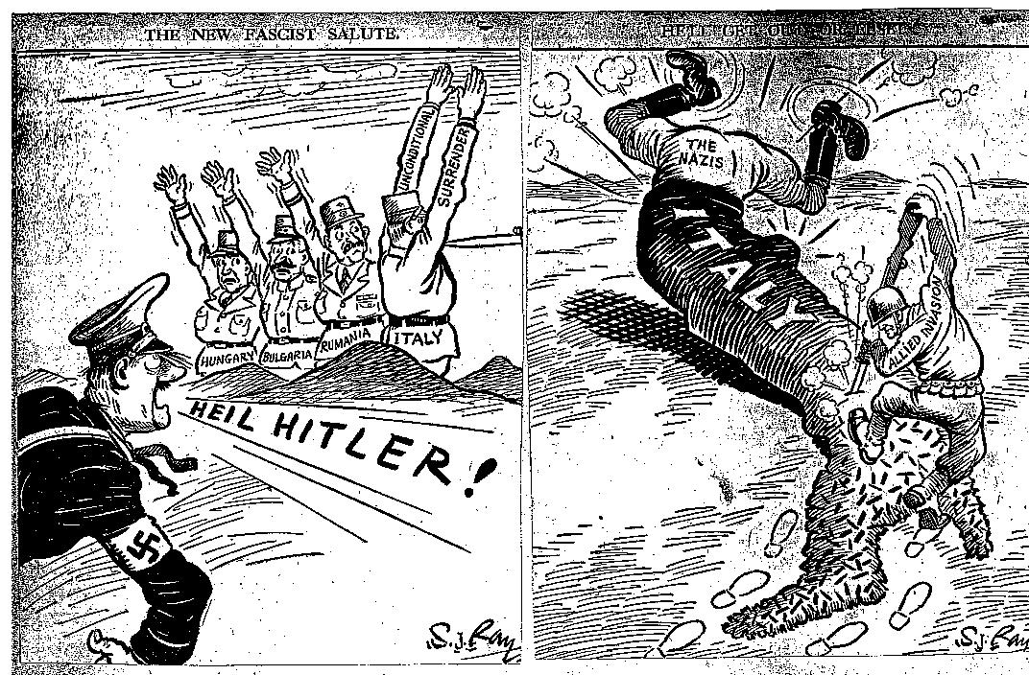
ALLIES INVADE SICILY
JULY–AUGUST 1943
335,000 TR00PS ANGLO-AMERICAN
AXIS FORCES RETREAT FROM SICILY

Slide 46
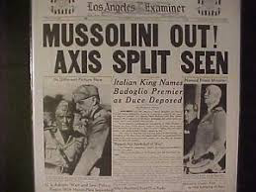
MUSSOLINI FALL FROM POWER JULY 25,1943
GRAND COUNCIL REMOVE MUSSOLINI WHO WAS SICK, TIRED, AND OVERWELMED BY MILITARY REVERSES
MARSHALL BADOGLIO MUSSOLINI SUCCESSOR
ITALY DECLARES WAR ON GERMANY OCT 13, 1943

Slide 47
ITALIAN CAMPAIGN
JULY 1943-MAY 1945
320,000 ALLIED CASUALTIES
NO OTHER CAMPAIGN COST MORE IN LIVES LOST AND WOUNDS SUFFERED
BRITAIN ADVOCATED SMALL PERIPHERIAL OPERATION
US FAVORED DIRECT ACTION AGAINST NAZI GERMANY

Slide 48
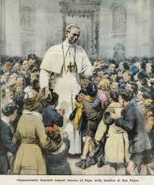
ROME FALLS TO ALLIES
JUNE 5,1944
PIUS XII GAVE THANKS FOR VICTORY
GENERAL MARK CLARK LED AMERICAN FORCES
GERMANS RETREAT TO GOTHIC LINE

Slide 49
WHY EISENHOWER APPOINTED SUPREME COMMANDER
FDR WANTED MARSHALL TO ORGANIZE MILITARY AND WORK WITH CONGRESS
MOST MASSIVE BUILD UP IN HISTORY
AMERICAN LEADER CHOSEN BECAUSE OUTNUMBER BRITISH CONTRIBUTIONS
SIR ARTHUR TEDDER CHOSEN DEPUTY SUPREME COMMANDER

Slide 50
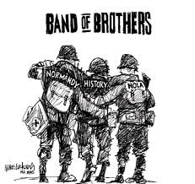
D-DAY INVASION
JUNE 6, 1944
LARGEST AMPHIBIOUS INVASION IN HISTORY
6993 VESSELS, 1213 WARSHIPS, 4,126 LANDING CRAFT, 20 CRUISERS
160,000 TROOPS FIRST DAY
875,000 TROOPS BY END OF JUNE

Slide 51
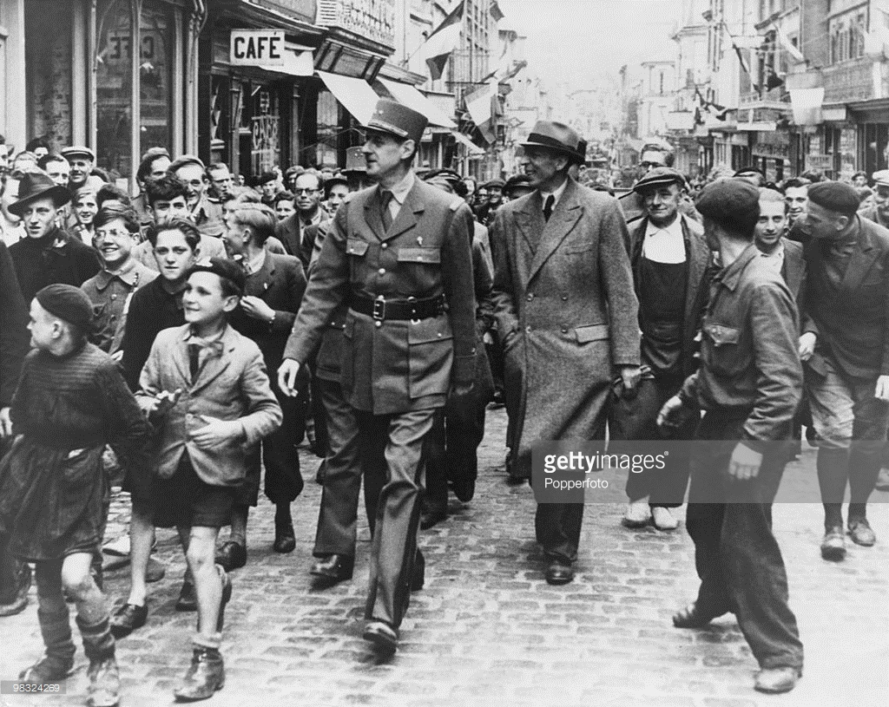
LIBERATION PARIS
AUGUST 19-25, 1944
CHARLES de GAULLE CONTROL CITY
GOAL DESTROY GERMAN ARMY NOT CAPTURE PARIS

Slide 52
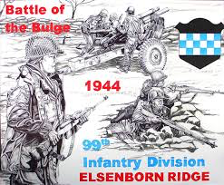
BATTLE OF THE BULGE
DEC 16-1944-JAN 25, 1944
LAST MAJOR GERMAN OFFENSIVE CAMPAIGN
SURPRISE ATTACK CAUGHT ALLIES OFF GUARD
STOP USE OF ANTWERP AND SPLIT ALLIED LINES

Slide 53
BATTLE OF THE BULGE
DEC 16-1944-JAN 25, 1944
406,000 GERMAN TOOPS; 610,000 AMERICAN TROOPS
MALMEDY MASSACRE: 84 AMERICAN POW SHOT
LAST GERMAN RESERVES LOST
BLACK TROOPS FOUGHT HEROICALLY

Slide 54
YALTA CONFERENCE
FEBRUARY 4-11, 1945
ROOSEVELT WANTED SOVIET SUPPORT AGAINST JAPAN
CHURCHILL WANTED FREE ELECTIONS AND DEMOCRATIC GOVERNMENTS IN EASTERAN AND CENTRAL EUROPE
STALIN WANTED POLITICAL INFLUENCE OVER EASTERN AND CENTRAL EUROPE

Slide 55
YALTA CONFERENCE
FEB 4-11, 1945
STALIN AGREED FRANCE WOULD HAVE 4TH OCCUPATION ZONE
FDR ASSURED CONGRESS YALTA LAID FOUNDATION FOR POSTWAR COOPERATION BETWEEN SOVIET UNION AND DEMOCRATIC WEST
FDR EXPLICITLY UNDERSTOOD THAT 10 MILLION RED ARMY CONTROLLED POLAND, HUNGRY, BULGARIA, RUMANIA

Slide 56
YALTA CONFERENCE
STALIN, CHURCHILL, FDR ARGUED INTENSELY ABOUT SPHERES OF INFLUENCE
POLAND BETRAYED
FDR: “IT IS PERMITTED IN TIME OF GRAVE DANGER TO WALK WITH THE DEVIL UNTIL YOU HAVE CROSSED THE BRIDGE.”
“HE WHO DINES WITH THE DEVIL BETTER HAVE A LONG SPOON.”

Slide 57
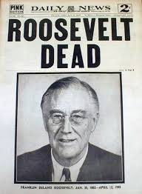
FDR DEATH WARM SPRINGS
APRIL 12, 1945
FORMER MISTRESS, LUCY MERCER, WAS IN ATTENDANCE
HARRY TRUMAN TAKES
OATH OF OFFICE

