Slide 1

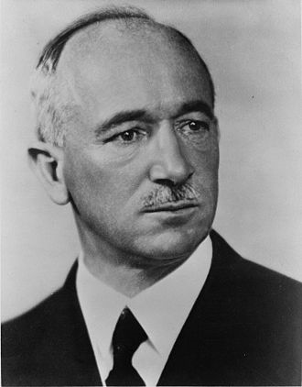

NEW LEADERS AFTER WORLD WAR I
STALIN: GEORGIAN NOT RUSSIAN
HITLER: AUSTRIAN NOT GERMAN
MUSSOLINI: SON OF BLACKSMITH
BENES: SON OF PEASANT

Slide 2
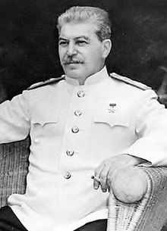
JOSEPH STALIN (1878-1953)
GOVERNED MID 1920’S-1953
CONSOLIDATED POWER AFTER LENIN’S DEATH 1924
SOCIALISM IN ONE COUNTRY

Slide 3
JOSEPH STALIN
TRANSFORMED COUNTRY INTO INDUSTRIAL POWER
KILLED OVER 20 MILLION RUSSIANS
FAMINE (1932-33) KILLED MILLIONS IN UKRAINE
GREAT PURGE-- ELIMINATE POLITICAL OPPONENTS
  600,000- 1,750,000 KILLED OR IMPRISONED

Slide 4
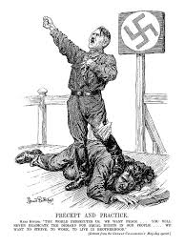
STRUGGLE AGAINST FASCISM
ON-GOING CONFLICT FROM 1918-1939
COMMUNISM: BELIEVE IN ECONOMIC EQUALITY AND CLASSLESS SOCIETY
FASCISM: NATIONALISTIC TOP-DOWN SYSTEM WITH RIGID CALL ROLES

Slide 5
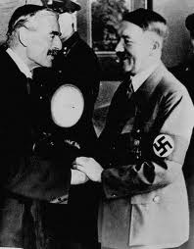
MUNICH: TRIUMPH OF NATIONAL SOCIALISM
9/28/1938
HITLER DEMANDS SUDETENNLAND
NO REPRESENTATIVES OF CZECHOSLOVAKIA, USSR
APPEASEMENT

Slide 6
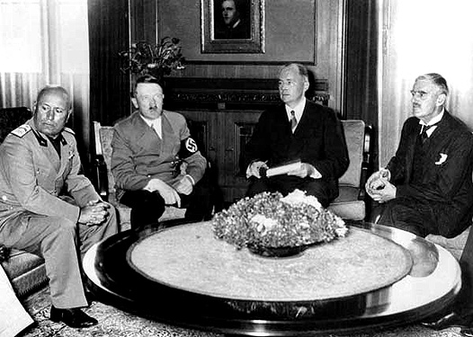
KEY PARTICIPANTS
CHAMBERLAIN
DALADIER
HITLER
MUSSOLINI

Slide 7
PURGE OF RUSSIAN ARMY 1937-1938
ONLY 5 OF 80 MEMBERS OF MILITARY SOVIET IN 1934 SURVIVE
ALL 11 DEPUTY COMMISARS ELIMINATED
EVERY COMMANDER OF MILITARY DISTRICT EXECUTED
13/15 ARMY COMMANDERS EXECUTED

Slide 8
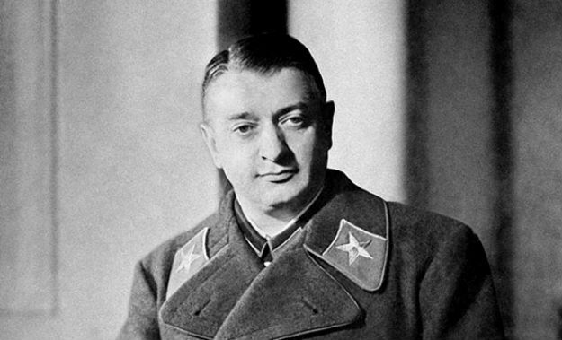
PURGE RED ARMY 1937-1938
STALIN PARANOIA AND DESIRE FOR TOTAL POWER
ACCUSED OF WORKING FOR NAZI GERMANY
REDUCED MILITARY EFFECTIVENESS
MARSHALL TUKHACHEVSKII
  CREATIVE THINKER,STRATEGIST

Slide 9

STALIN: ATTITUDE AFTER MUNICH
UNDERSTOOD THAT FRANCE AND BRITAIN WANTED WAR BETWEEN GERMANY & USSR
COLLECTIVE SECURITY DEAD
WE WILL NOT PULL “CHESTNUTS OUT OF FIRE FOR BRITISH EMPIRE

Slide 10
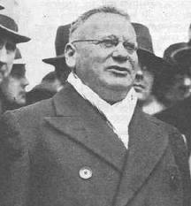
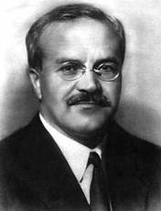
STALIN
NO LONGER TRUSTED FRENCH ALLIANCE
REPLACED JEWISH LITVINOV WITH RUSSIAN MOLOTOV 5/3/39
MAXIM LITVINOV
MOLOTOV

Slide 11
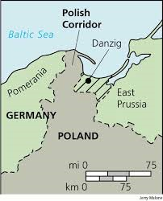
POLAND
DANZIG & POLISH CORRIDOR
ENGLISH GIVE “UNCONDITIONAL GUARANTEE” MARCH 1939
HITLER “COOK THEM A STEW THEY WILL CHOKE ON”

Slide 12
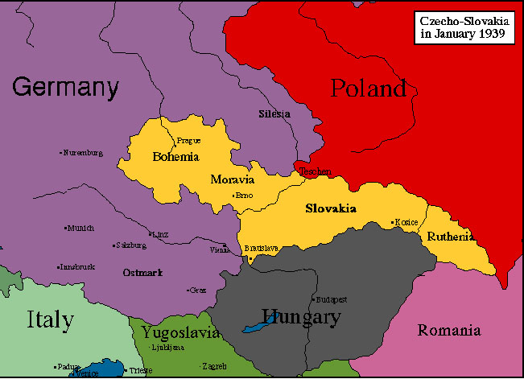
FOREIGN RELATION PROBLEMS POLAND
HUNGARY AND ITALY PREFERRED ALIGNMENT WITH GERMANY OVER POLAND
POLAND SEIZED TESCHEN DISTRICT OF CZECHOSLOVAKIA
REFUSED TO JOIN ANTI-COMINTERN PACT

Slide 13
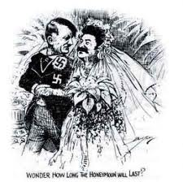
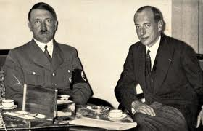
POLISH DILEMMA
WITH GERMANY WE LOSE OUR LANDS
WITH SOVIETS WE LOSE OUR SOUL
FOREIGN MINISTER
BECK

Slide 14
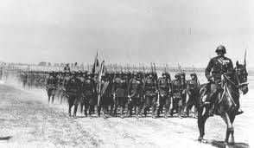
POLISH DILEMMA
WILL NOT ACCEPT RUSSIAN TROOPS INTO POLAND
POLISH CAVALRY

Slide 15
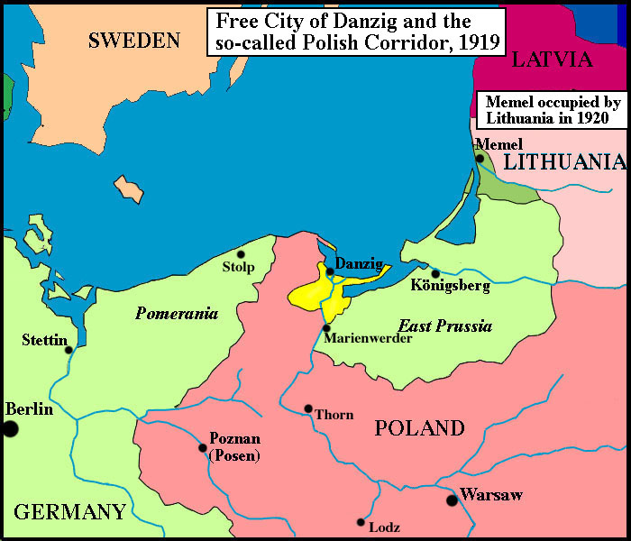
POLAND

Slide 16
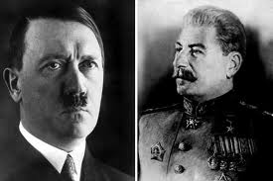
NON-AGGRSSION PACT
HITLER
STALIN

Slide 17
GERMAN-SOVIET NON AGGRESSION PACT SECRET PROTOCOLS
SPLIT POLAND
GIVE BALTIC STATES USSR
GIVE ROMANIA TO GERMANS

Slide 18
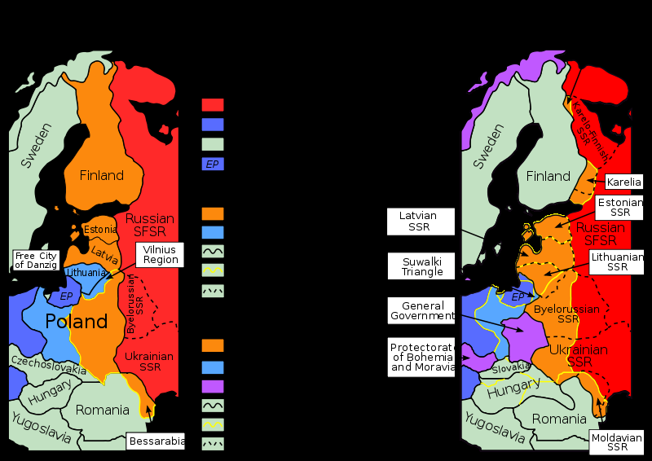
DIVISION OF EUROPE
PLANNED
ACTUAL

Slide 19
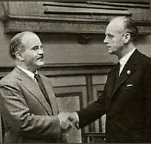
MOLOTOV RIBBENTROP NON-AGGRESSION PACT
SHOCKED WORLD
“HARD ASS” MOLOTOV
RIBBENTROP
AUGUST 23, 1941

Slide 20
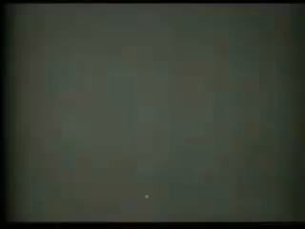
MOLOTOV RIBBENTROP NON-AGGRESSION PACT

Slide 21
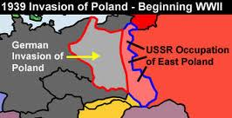
WW II BEGINS
SEPT 1 GERMANY ATTACKS POLAND
BLITZKRIEG
SOVIET UNION OCCUPIES EASTERN POLAND (9/17)
SOVIET OCCUPY BALTIC STATES

Slide 22
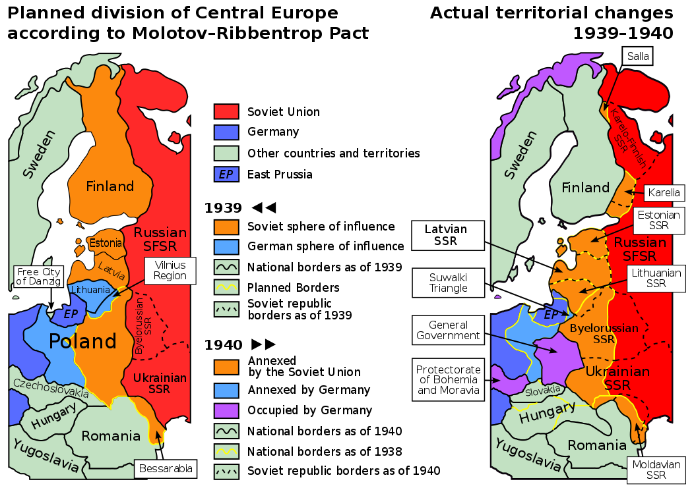
SECRET PACT

Slide 23
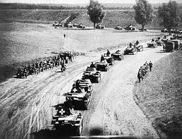
GERMAN TANK INVASION

Slide 24
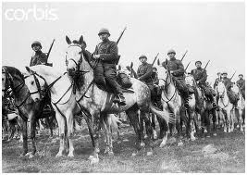
POLISH CAVALRY

Slide 25
POLISH CAMPAIGN
RELUCTANT CHAMBERLAIN DECLARES WAR SEPT 3
CHAMBERLAIN HAD NO STOMACH FOR WAR—NOT BOMB GERMANY
NO FRENCH OR BRITISH MOVEMENT INTO GERMANY
FIRST BRITISH TROOP DIED DECEMBER 1939

Slide 26
INVASION POLAND & USSR
EUROPE’S LARGEST JEWISH COMMUNITIES
EINSATZGRUPPEN (SS UNITS) ROUND UP JEWS INTO GHETTOS
POLAND DUMPING GROUND FOR EUROPEAN JEWS
1 MILLION JEWS KILLED IN FIRST MONTHS GERMAN INVADE RUSSIA

Slide 27
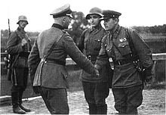
GERMAN RUSSIAN COOPERATION
GERMAN RUSSIAN SHAKE HANDS IN POLAND
COMMUNISTS THROUGHOUT WORLD PRESS FOR PEACE

Slide 28
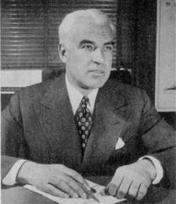
LEND LEASE MARCH 1941
CRITICAL TO ALLIED SUCCESS
$50 BILLION
2/3RD GREAT BRITAIN
END AMERICAN ‘OFFICIAL’ NEUTRALITY
EDWARD STETTINIUS

Slide 29
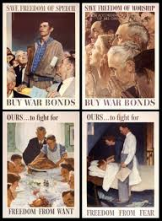
FOUR FREEDOMS
RATIONALE FOR AMERICA GIVING UP NEUTRALITY
FREEDOM OF SPEECH
FREEDOM OF RELIGION
FREEDOM FROM WANT
FREEDOM FROM FEAR

Slide 30
HITLER’S MISTAKE ATTACKING RUSSIA. JUNE 22,1941
HITLER FAILED TO RECOGNIZE SIZE OF SOVIET UNION
POOR TRANSIT CONDITIONS
SEVERE WEATHER CONDITION
GERMAN ARMY NOT PREPARED FOR LONG WAR

Slide 31
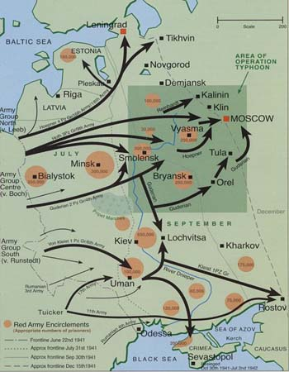
OPERATION BARBAROSSA
JUNE 22, 1941

Slide 32
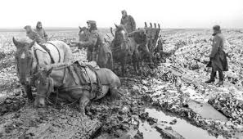
HITLER COMMENTS
“YOU ONLY HAVE TO KICK IN DOOR AND WHOLE ROTTEN STRUCTURE WILL COME CRUMBLING DOWN.”

Slide 33
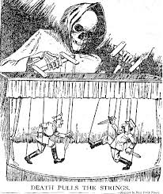
OPERATION BARBAROSSA
LARGEST MILITARY OPERATION IN HISTORY
NO RESPECT FOR INTERNATIONAL LAW
JUDAIC-BOLSHEVISM IS MORTAL ENEMY OF NAZI STATE
COMPLETE CRUSHING JEWISH-BOLSHEVIK SYSTEM

Slide 34
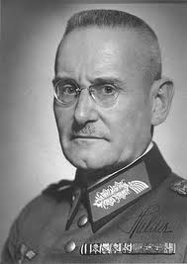
GERMAN GAINS JUNE JULY 1940
GENERAL HALDER: “RUSSIA LOST WAR IN FIRST 2 WEEKS”
CAPTURE BALTICS
GENERAL HALDER

Slide 35
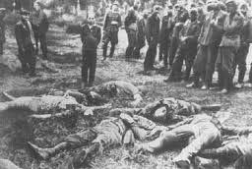
EINSATZGRUPPEN
SS UNITS KILL 1 MILLION RUSSIANS IN FIRST FEW MONTHS, MOSTLY JEWS

Slide 36
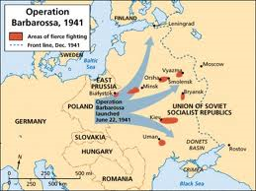
HITLER’S DIRECTIVE
LENINGRAD AND MOSCOW WILL BE BURNT TO THE GROUND
GERMANY HAD NO RESPONSIBILITY FOR CIVILIAN WELFARE

Slide 37
GERMAN PROBLEMS
GERMANS OUTDISTANCE SUPPLIES
TERRAIN AND WEATHER MORE DIFFICULT THAN ANTICIPATED
RED ARMY RESISTED TENACIOUSLY
SOVIET T-34 TANKS
SOVIETS DISMANTLE 1500 PLANTS & FACTORIES

Slide 38
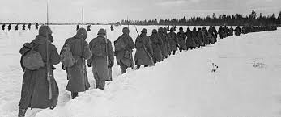
FAILURE BARBAROSSA
DID NOT DESTROY RED ARMY
DID NOT CAPTURE MOSCOW OR LENINGRAD
GERMANS LOST 1 MILLION TROOPS…33%
GERMAN TROOPS NO WINTER CLOTHES

Slide 39
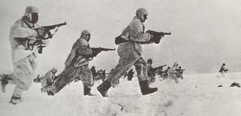
BLITZKRIEG OVER
DEC 6.1941
RUSSIAN COUNTERATTACK BEFORE MOSCOW
MARSHAL ZHUKOV CAUGHT GERMANS BY SURPRISE
RUSSIANS FOUGHT FEROCIOUSLY BEHIND GERMAN LINES

Slide 40
HITLER’S MISTAKE
UNWILLING TO FURNISH SOLDIERS WINTER CLOTHING
CAPTURE MOSCOW, LENINGRAD, CAUCASUS TOO AMBITIOUS

Slide 41
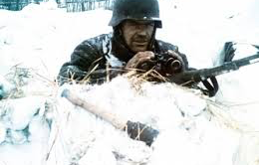
NO WINTER CLOTHING

Slide 42
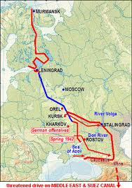
GERMAN 1942 MILITARY OBJECTIVE

Slide 43
BATTLE OF STALINGRAD: AUG 1942-MARCH 1943
STALINGRAD KEY TO BLOCKING GERMAN FROM CAUCASUS OIL
ZHUKOV COUNTERATTACK NOV 19 ENCIRCLE GERMAN 6TH ARMY
CATASTROPHIC GERMAN DEFEAT
200,000 KILLED; 90,000 CAPTURED

Slide 44
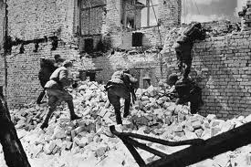
BATTLE OF STALINGRAD AUG 1942-MARCH 1943
ZHUKOV COUNTERATTACK NOV 19 ENCIRCLE GERMAN 6TH ARMY
STALINGRAD KEY TO BLOCKING GERMAN FROM CAUCASUS

Slide 45
HITLER MAJOR MISTAKE
HITLER ALLOWED NO RETREAT
LED TO LOSS OF SIGNIFICANT NUMBER OF SOLDIERS

Slide 46

LECTURE 4

Slide 47
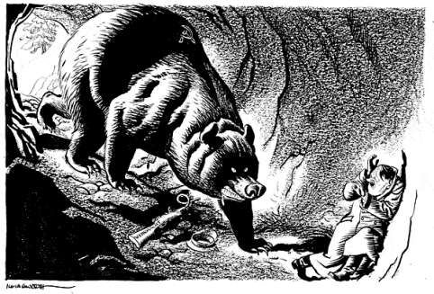
BATTLE KURSK SUMMER 1943
LARGEST ARMORED BATTLE IN HISTORY
3,000 TANKS
MARKED END OF GERMAN ABILITY TO LAUNCH PANZER OFFENSIVES

Slide 48
RUSSIAN SUMMER OFFENSIVE 1944
DIRECTED AGAINST GERMAN ARMY CENTER GROUP
REACHED PREWAR FRONTIER OF POLAND
STOPPED BEFORE WARSAW ALLOWED GERMANS TO REGROUP

Slide 49
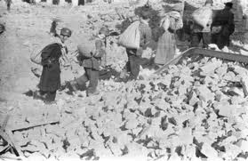
WARSAW UPRISING
AUG 1-OCT 1, 1944
POLISH HOME ARMY STAGED UPRISING
RUSSIANS LOOKING TO POST WW II
CITY TOTALLY DESTROYED
200,000 WARSAW INHABITANTS DIED
85% WARSAW DESTROYED

Slide 50
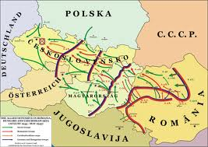
FALL 1944 RUSSIANS PUSH
FINLAND, ROMANIA, BULGARIA, SLOVAKIA, HUNGARY DESERT GERMAN ALLIANCE

Slide 51
RED DRIVE THROUGH POLAND JAN 1945
1.5 MILLION TROOPS
3300 TANKS
10,000 AIRCRAFT
GERMANS ONLY HAD 600,000 TROOPS, 700 TANKS

Slide 52
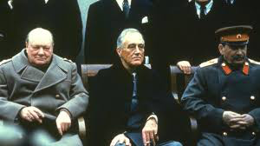
YALTA CONFERENCE
FEB 4-FEB 11, 1945
GERMANY DIVIDED INTO 4 ZONES
GERMANY DEMILITARIZED
FORCED LABOR OF GERMANS
POLAND EFFECTIVELY CEDED TO SOVIET UNION

Slide 53
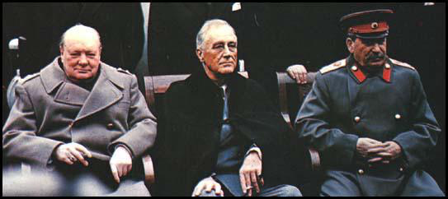
YALTA (FEB 4-11, 1945)
IN REALITY RED ARMY OCCUPATION DETERMINED POST-WAR MAP
STALIN MUCH BETTER PREPARED THAN ROOSEVELT AND CHURCHILL
SOVIET UNION JOIN U.N.

Slide 54
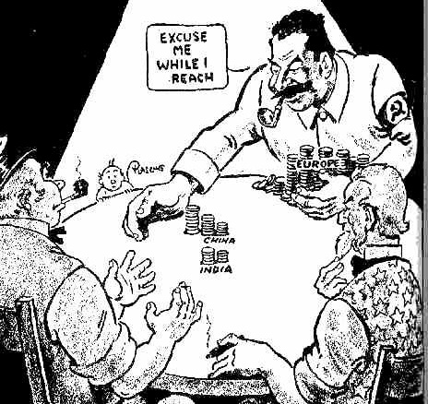
YALTA
STALIN AGREED TO FIGHT JAPAN WITHIN 90 DAYS OF GERMAN SURRENDER
NAZI CRIMINALS WOULD BE LEGALLY PERSECUTED

Slide 55
CHURCHILL IRON CURTAIN SPEECH
CONDEMN SOVIET UNION
STETTIN IN BALTIC TO TRIESTE IN ADRIATIC
PRAISED AMERICA PINNACLE OF POWER
CONDEMNED COMMUNIST 5TH COLUMN

Slide 56
STALIN’S MILITARY RECORD
BOTH STALIN AND HITLER ENCOURAGED THE DEATH OF MILLIONS OF CIVILIANS AND SOLDIERS.
DEMOCRATIC LEADERS SUCH AS FDR AND CHURCHILL WERE CONSTRAINED BY THEIR ELECTORATE

Slide 57
STALIN SHOCKED BY GERMAN INVASION
STALIN DISCOUNTED THOUSANDS OF MESSAGES REGARDING GERMAN UPCOMING ATTACK
“LENIN LEFT US A GREAT LEGACY, AND WE HAVE FUCKED IT UP”

Slide 58
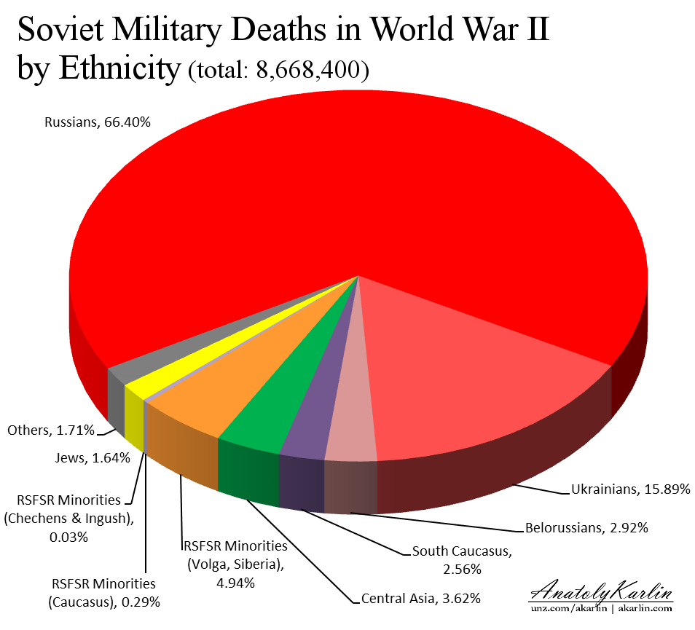
CASUALTIES SOVIET UNION
BETWEEN 20-26 MILLION KILLED
8.7 MILLION MILITARY DEATHS
3 MILLION POW DIED

